Slide 1
Business model and solution proposal
Group 6
Nina Marie Wahl Carl Emil Hattestad Armelle Rivière Aleksi O’Connor Anna Bellika Kjæmpenes

Slide 2
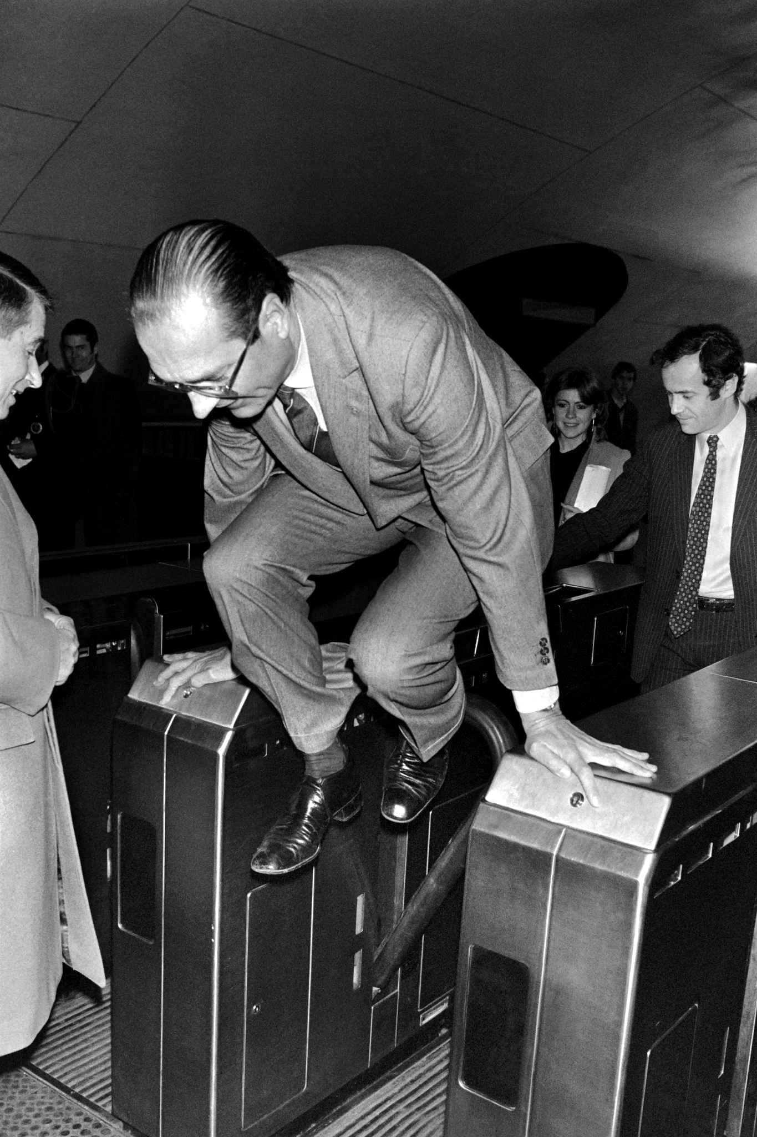
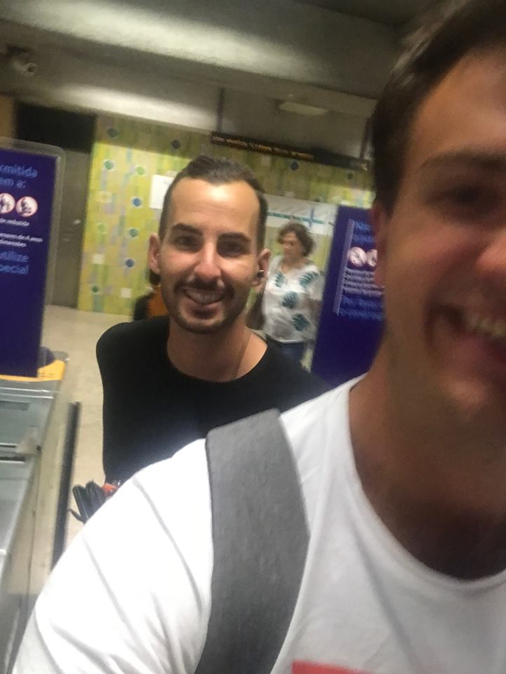

The problem
!

Slide 3

Our Idea
Glass panels after card validation
Passing the panel without a validated ticket → Red trail
System is in doubt → Yellow trail
Gather data on how many people travel without a travel card
Notes:
Alternative to the other slide

Slide 4
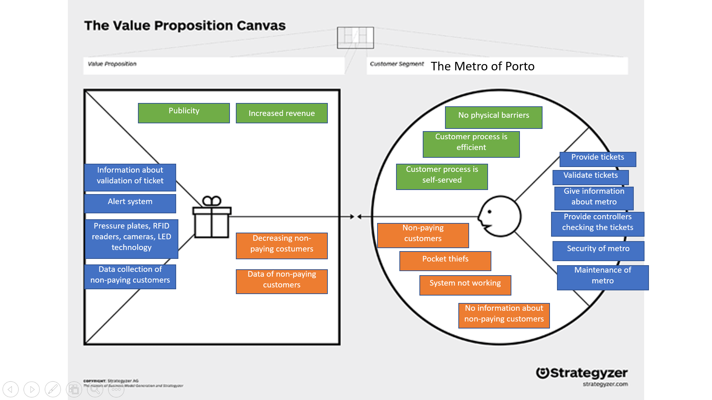
Value proposition

Slide 5
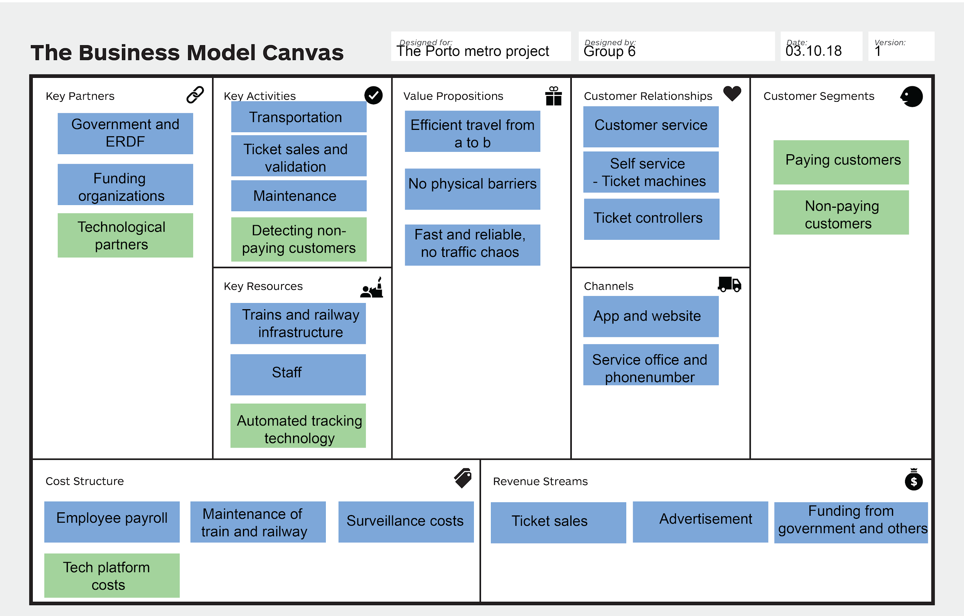
Business model canvas

Slide 6


How will our solution tackle the problem?
Pressure plates, RFID readers, cameras, LED technology
Pressure sensors in combination with cameras and RFID readers
System will employ further use of analysis of camera input
Combination of data will be analyzed programmatically

Slide 7
